Slide 1
WSS Data Collection Program Wiedemann-Steiner Syndrome Data Progress Report - November 2023

Slide 2
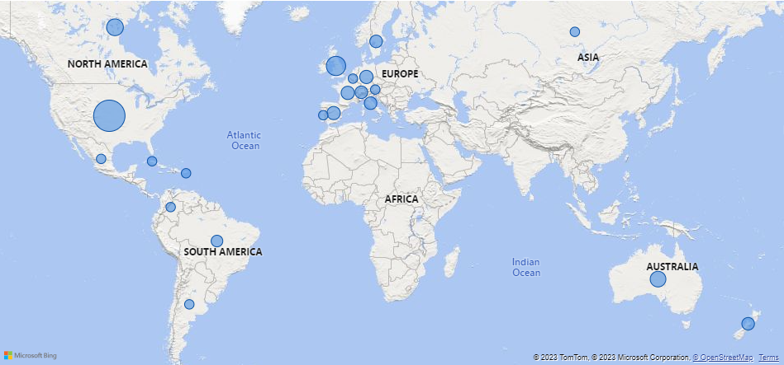
This report reflects the enrollment and completed surveys of 178 individuals diagnosed with WSS between the launch of the program on September 1, 2022 and November 20, 2023.
Patient Locations Across the Globe

Slide 3
Percentage KMT2A Mutation Types Reported

Slide 4
Overview of Reported Issues

Slide 5
Completion Rate of Relevant Surveys

Slide 6
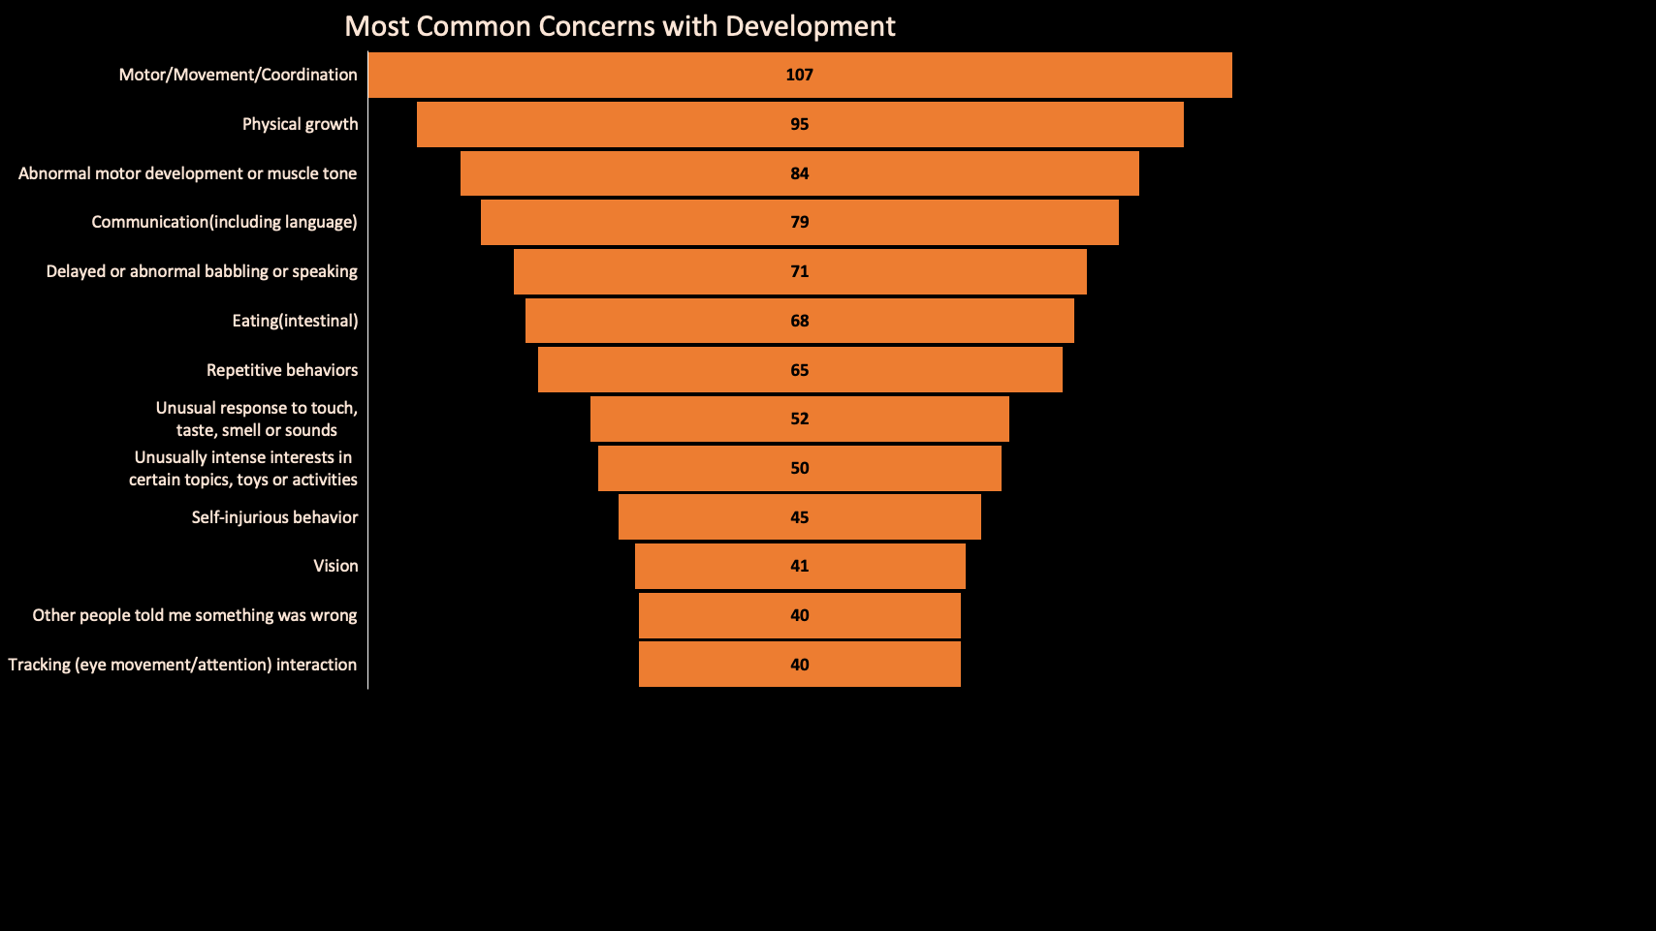

Slide 7
Total Complete: 80
Surveys still Needed: 30

Slide 8
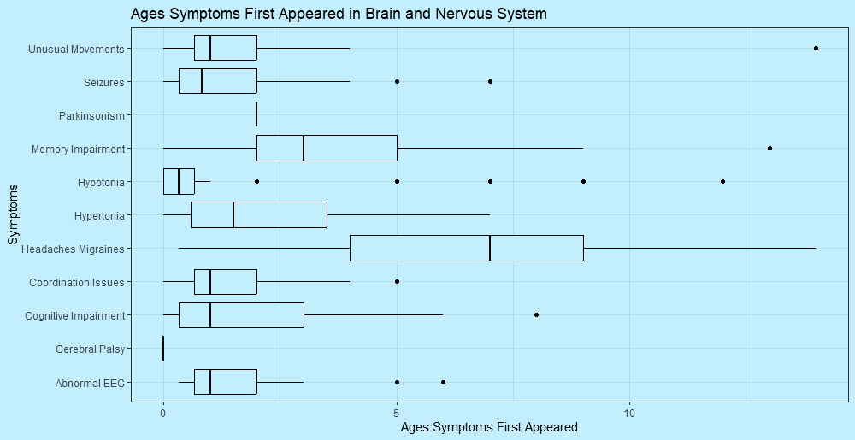

Slide 9
Total Complete: 85
Surveys still Needed: 19

Slide 10
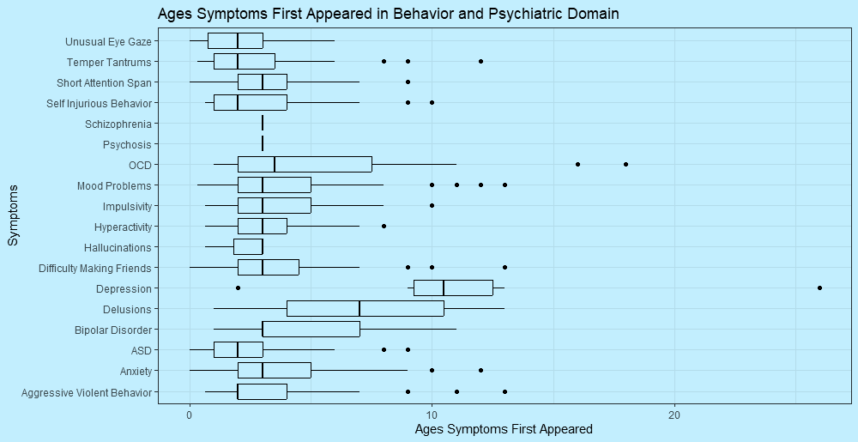

Slide 11
Total Complete: 87
Surveys still Needed: 17

Slide 12
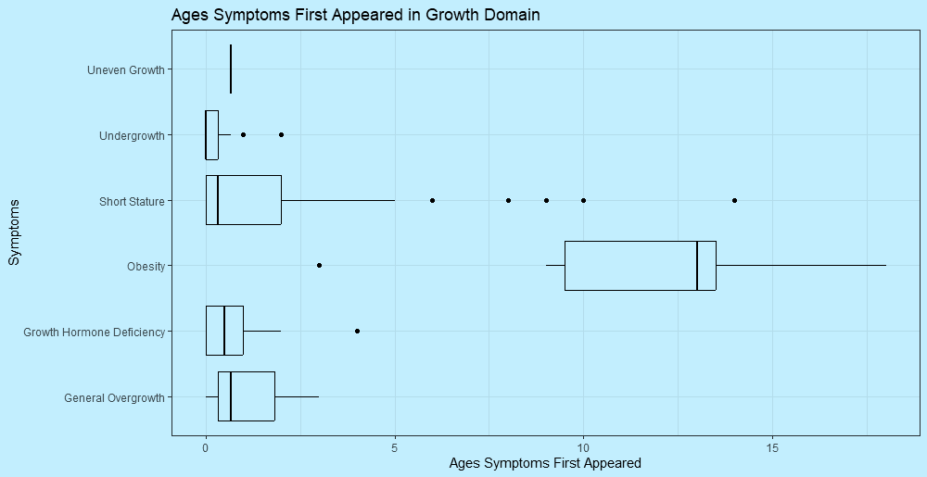

Slide 13
Total Complete: 69
Surveys still Needed: 27

Slide 14
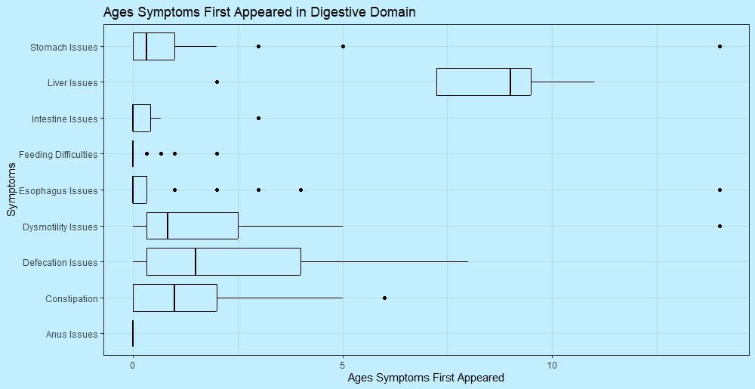

Slide 15
Total Complete: 67
Surveys still Needed: 31

Slide 16
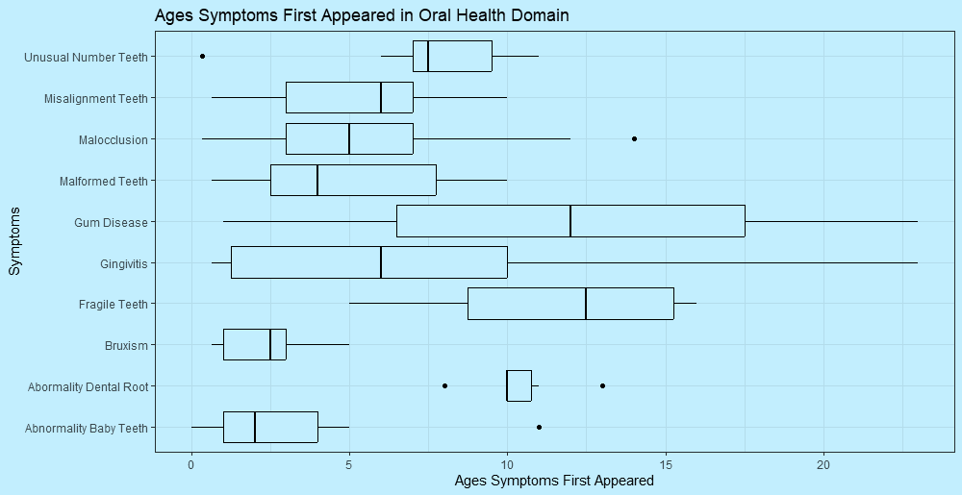

Slide 17
Total Complete: 70
Surveys still Needed: 22

Slide 18
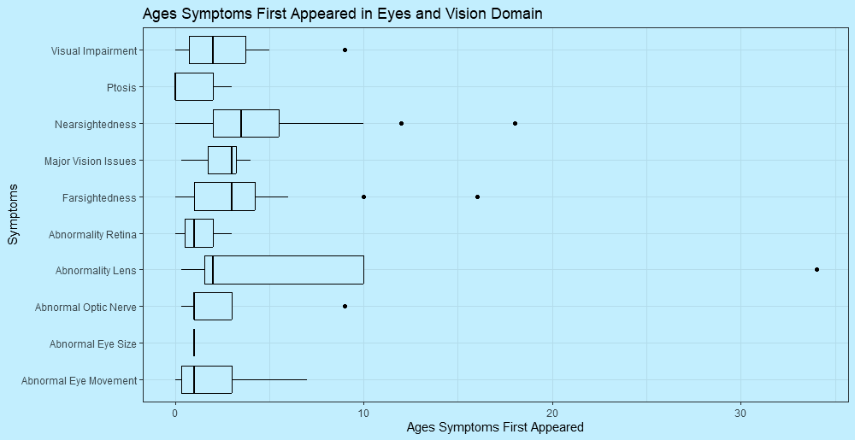

Slide 19
Total Complete: 62
Surveys still Needed: 28

Slide 20
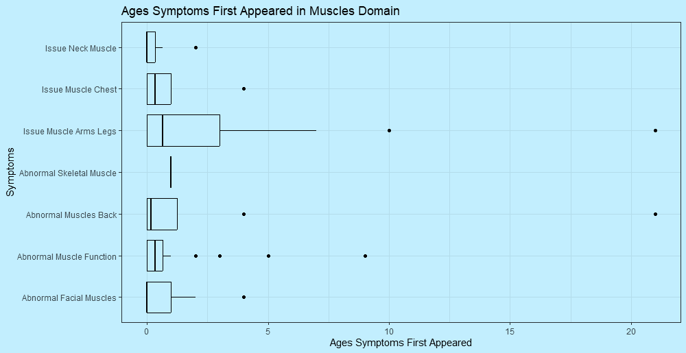

Slide 21
Total Complete: 48
Surveys still Needed: 20

Slide 22
Total Complete: 44
Surveys still Needed: 23

Slide 23
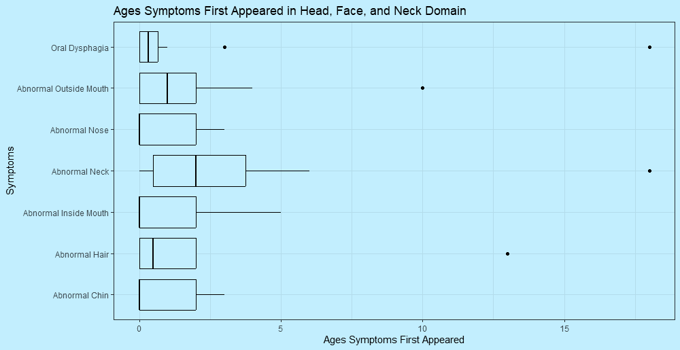

Slide 24
Total Complete: 49
Surveys still Needed: 10

Slide 25
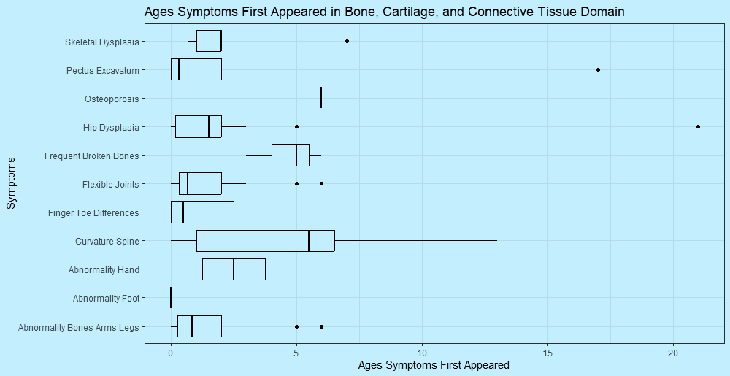

Slide 26
Total Complete: 35
Surveys still Needed: 16

Slide 27
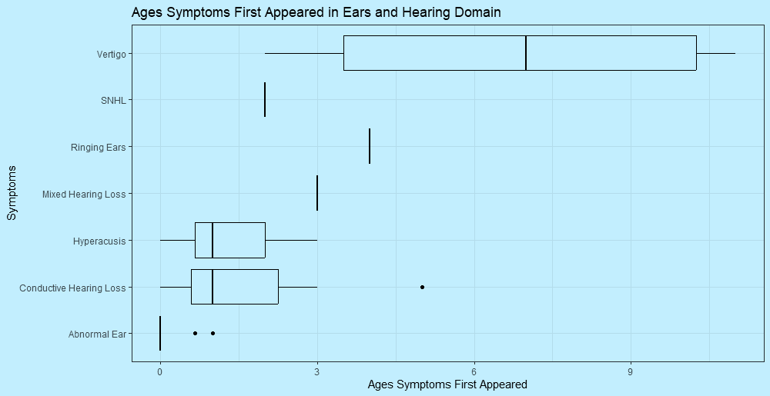

Slide 28
Total Complete: 41
Surveys still Needed: 11

Slide 29
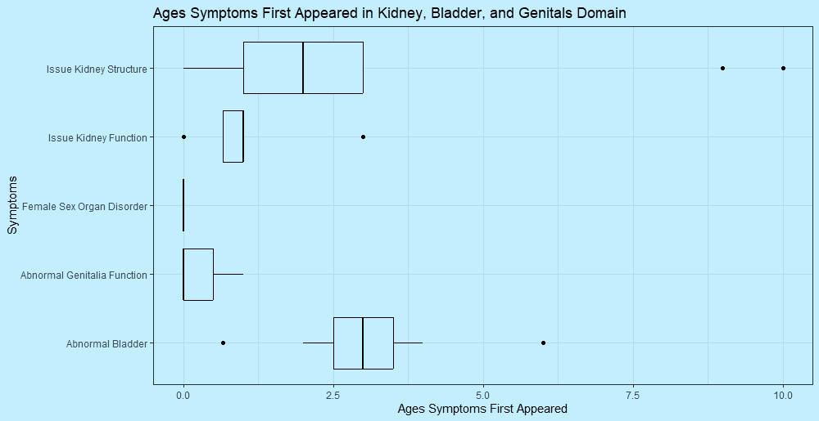

Slide 30
Total Complete: 34
Surveys still Needed: 15

Slide 31
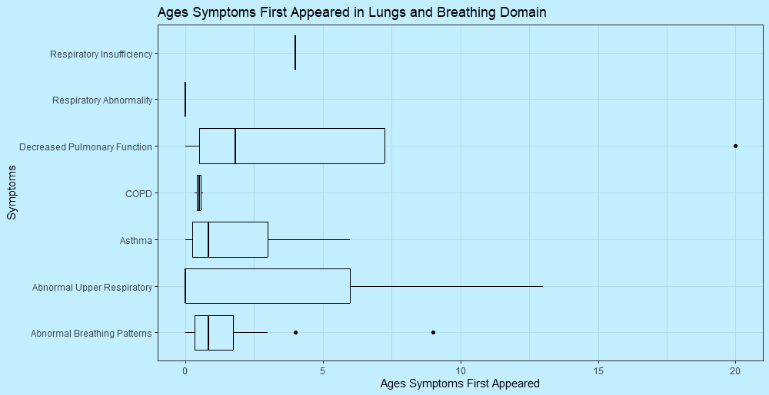

Slide 32
Total Complete: 32
Surveys still Needed: 16

Slide 33
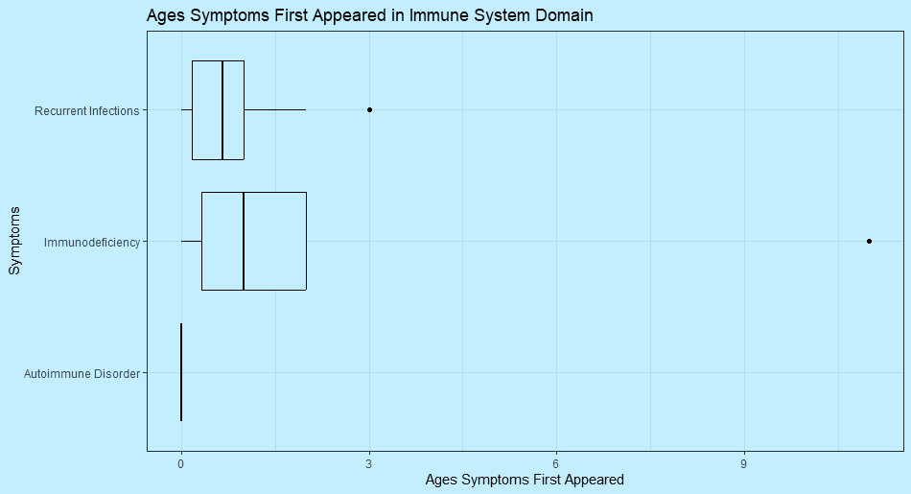

Slide 34
Total Complete: 35
Surveys still Needed: 18

Slide 35
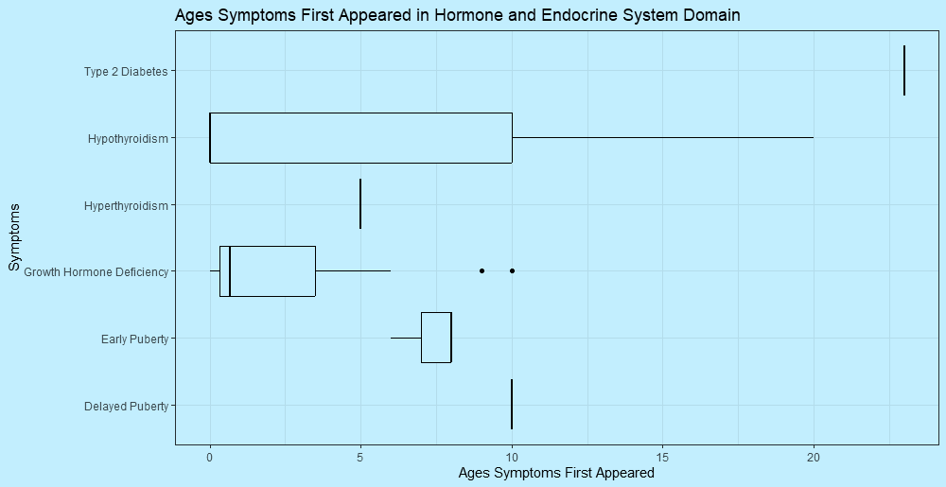

Slide 36
For more information: www.wssfoundation.org or info@wssfoundation.org To participate, enroll at: wss.rare-x.org

