Slide 1
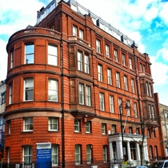

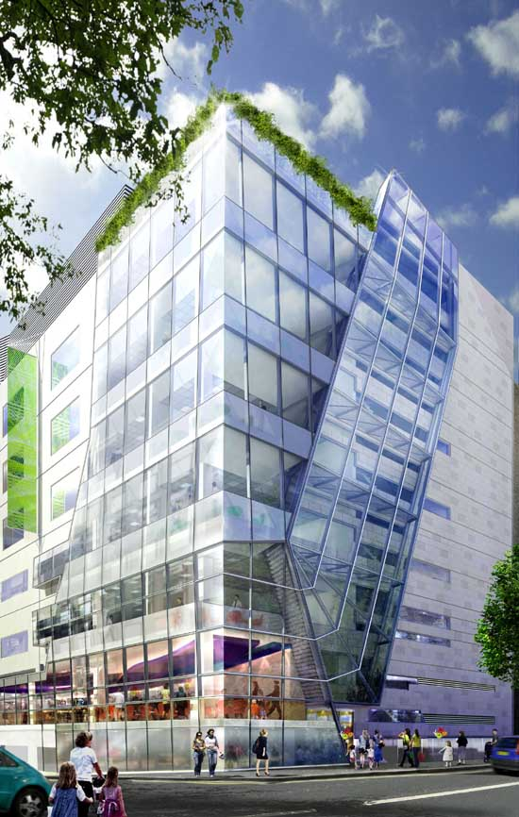


Wiedemann-Steiner Syndrome
Dr Wendy Jones MBBS MRCP
Great Ormond Street Hospital for Children
Orlando October 2017

Slide 2
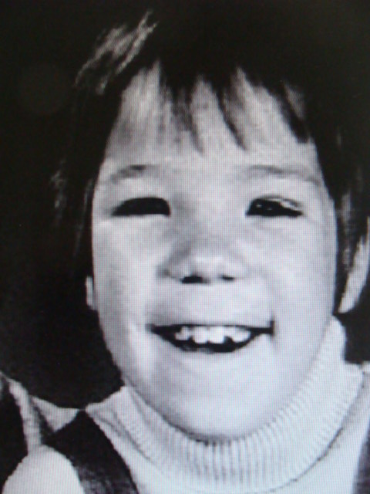
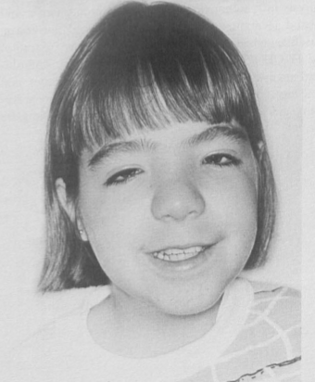
Wiedemann-Steiner syndrome
^{Dr Hans Rudolf Wiedemann}
Dr Carlos Steiner
‘Syndrome’
Comes from a Greek word which means
‘to come together’.
Describes features that are seen together in a certain condition
Wiedemann et al, 1989. Atlas der klinischen Syndrome / Steiner, 2000, Clin Dysmorphol,

Slide 3
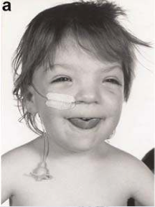
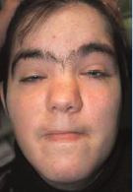
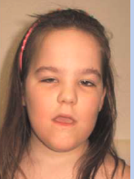
What is Wiedemann-Steiner syndrome?
Wiedemann et al, 1989. Atlas der klinischen Syndrome / Steiner, 2000, Clin Dysmorphol,
Koenig et al. 2010. Am J of Med Genet

Slide 4
Features
WSS causes a range of features.
Not everyone with WSS will have all of the features.
Each person with a certain feature won’t necessarily be affected by it to the same level as other people with that feature.
Doctors and scientists are still learning about WSS and in the future, more will be known about the features of the condition, and how commonly these are seen.

Slide 5
What causes Wiedemann-Steiner syndrome?
Until 2012 nobody knew what the underlying cause was
In 2012 through research we carried out a broad test that looked across all of the genes (whole exome sequencing)
We found that a having an alteration (mutation) in a one copy of gene called KMT2A causes WSS.
Jones et al, Am J Hum Genet. 91, 358–364, August 10, 2012

Slide 6
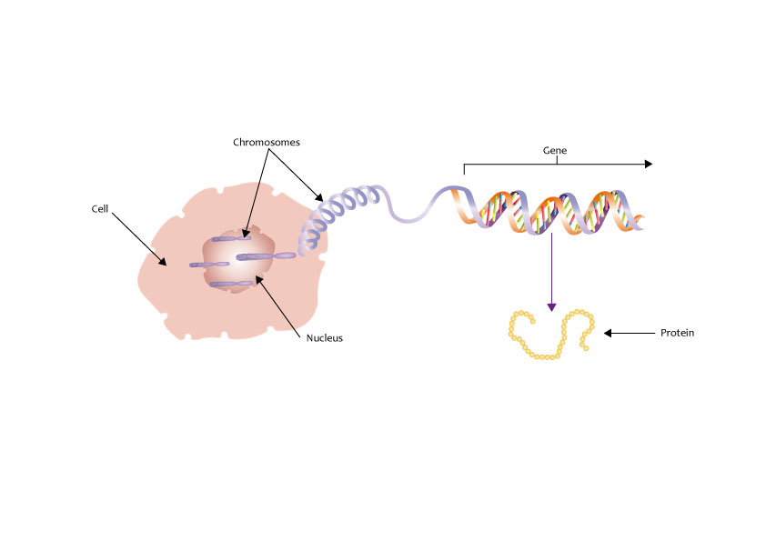
What are genes?
Genes give the body instructions how to grow and develop and function
We have around 21,000 genes
They are found in most cells of our body
All our genes come in pairs and we inherit one gene of each pair from each of our parents

Slide 7
The structure of DNA, genes & chromosomes

Slide 8
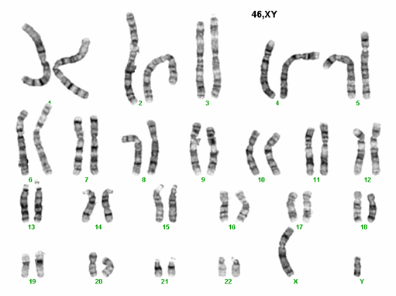
Chromosomes
Chromosomes are made of DNA.
Each contains genes in a linear order.
Human body cells contain 46 chromosomes in 23 pairs – one of each pair inherited from each parent
Chromosome pairs 1 – 22 are called autosomes.
The 23rd pair are called sex chromosomes:
XX is female, XY is male.
The KMT2A gene is located on chromosome 11

Slide 9
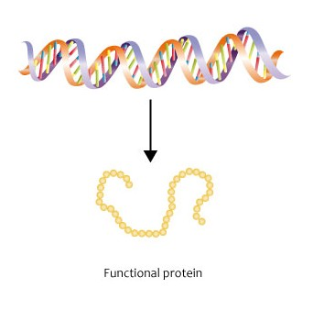
Each of our genes gives our body instructions to make a specific protein
Collagen
Haemoglobin
KMT2A

Slide 10
What does the KMT2A protein do?
KMT2A gene
KMT2A protein
Enzymes are biological molecules (typically proteins) that significantly speed up the rate of virtually all of the chemical reactions that take place within cells.
They are vital for life and serve a wide range of important functions in the body, such as aiding in digestion and metabolism.
Some enzymes help break large molecules into smaller pieces that are more easily absorbed by the body. Other enzymes help bind two molecules together to produce a new molecule.
Enzymes are very specific catalysts and usually work to speed up one reaction
Notes:
Enzymes are proteins that act as catalysts and help complex reactions occur everywhere in life
Enzymes are very specific catalysts and usually work to complete one task

Slide 11
The KMT2A protein is an enzyme
It catalyzes a reaction that involves the DNA itself
The KMT2A enzyme tells DNA to be ‘open’ (be less tightly wound up) or ‘closed’ (be more tightly wound up) by catalyzing a reaction on the proteins that DNA wraps around
This affects
the manufacture of
other proteins in the
body

Slide 12
Summary
The KMT2A gene gives the body instructions to make a protein called KMT2A
The KMT2A protein is an enzyme
The KMT2A enzyme tells DNA to be ‘open’ (be less tightly wound up) or ‘closed’ (be more tightly wound up) by catalyzing a reaction on the proteins that DNA wraps around
Having a alteration in one copy of the KMT2A gene affects the manufacture of a number of proteins in the body and this likely causes the features of Wiedemann-Steiner syndrome

Slide 13
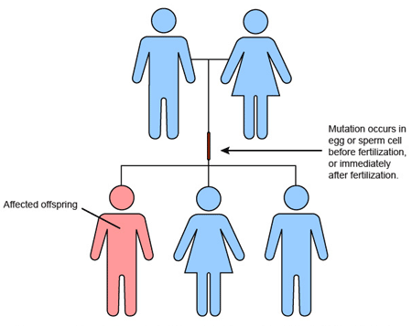
What is a de novo alteration (mutation)?

Slide 14
de novo alteration (mutation)?
A couple who have a child with a KMT2A alteration and WSS, but who did not carry the KMT2A alteration themselves on a blood test have a low chance of having a further child with WSS.

Slide 15
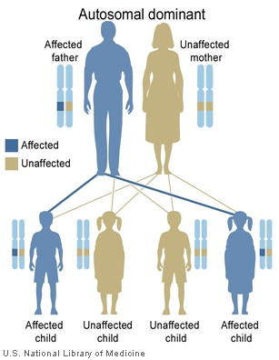
What is the inheritance if you have WSS?
If a person with WSS and a KMT2A alteration has children the chance of them passing on the condition to each of their children is 1 in 2 (50%). This is known as ‘autosomal dominant’ inheritance.
If people with WSS or their parents are planning a pregnancy and would like to discuss their options they should contact their local genetics centre.

Slide 18
The structure of DNA, genes & chromosomes

Slide 19
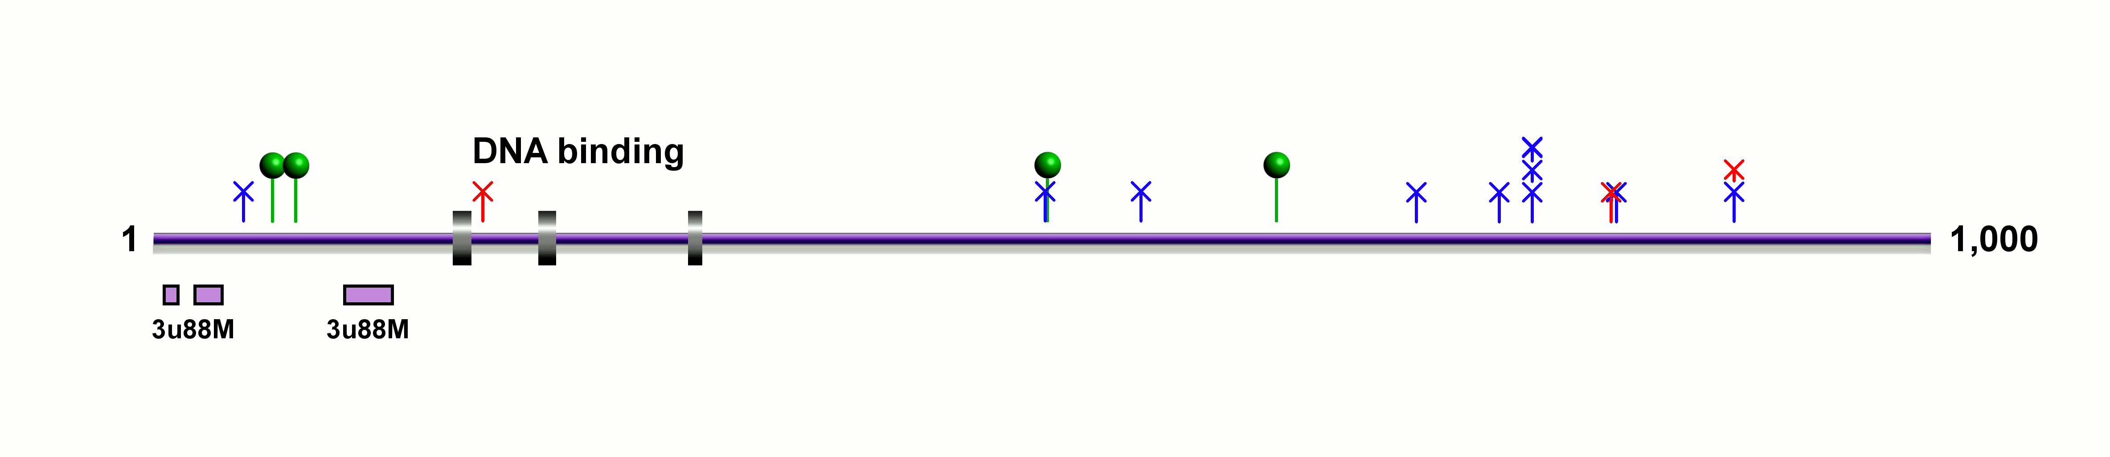
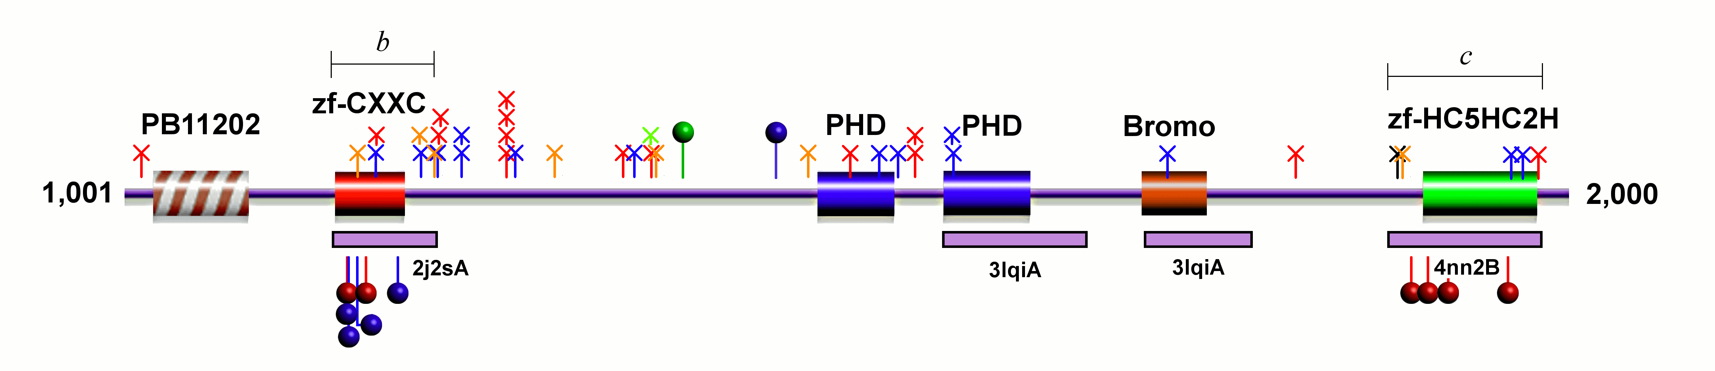
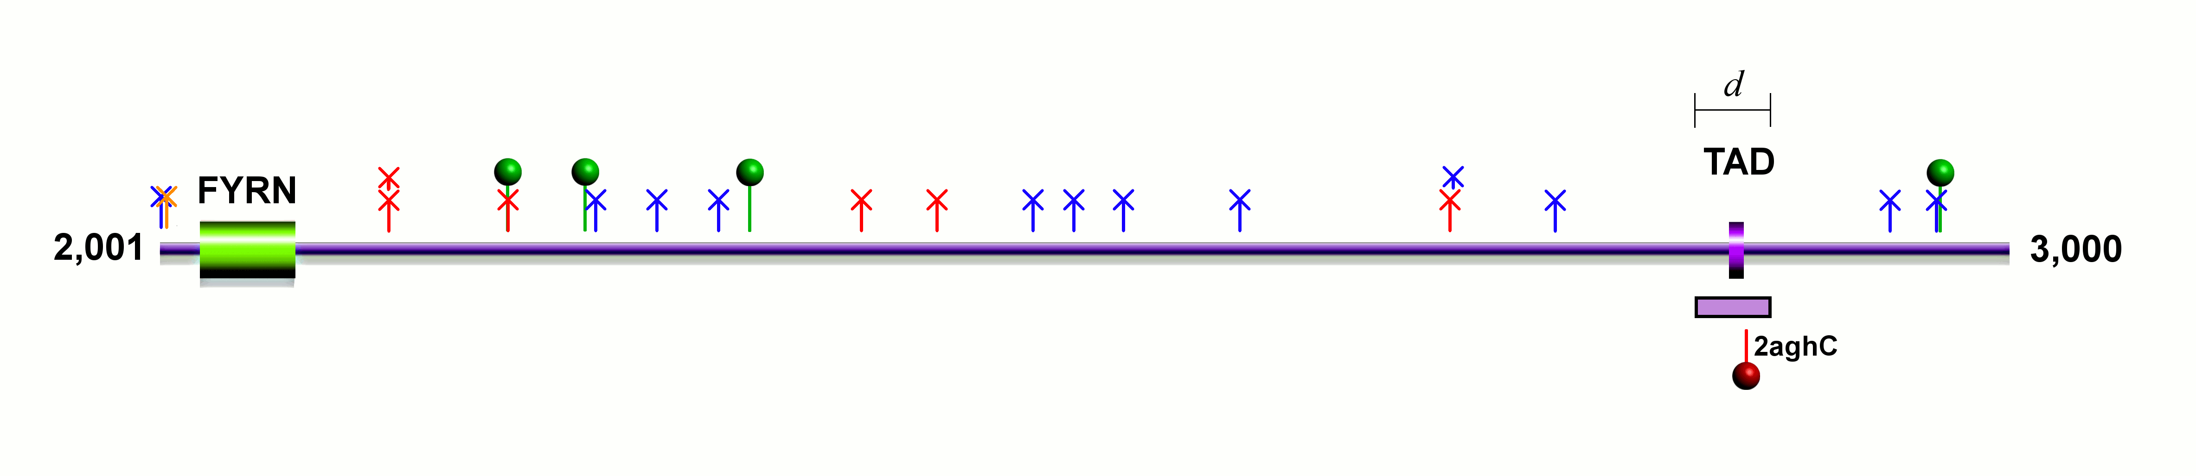
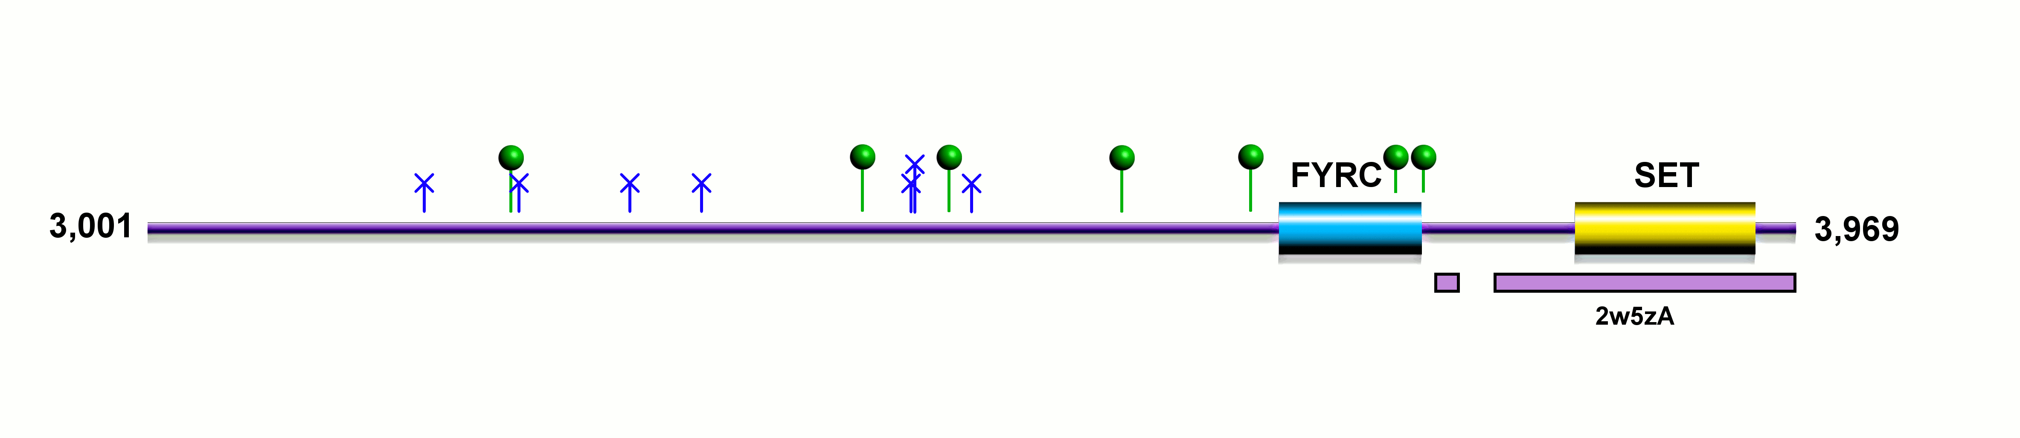
Figure 1: Distribution of KMT2A variants in individuals with Wiedemann-Steiner syndrome and control missense variants from the ExAC database

Slide 20
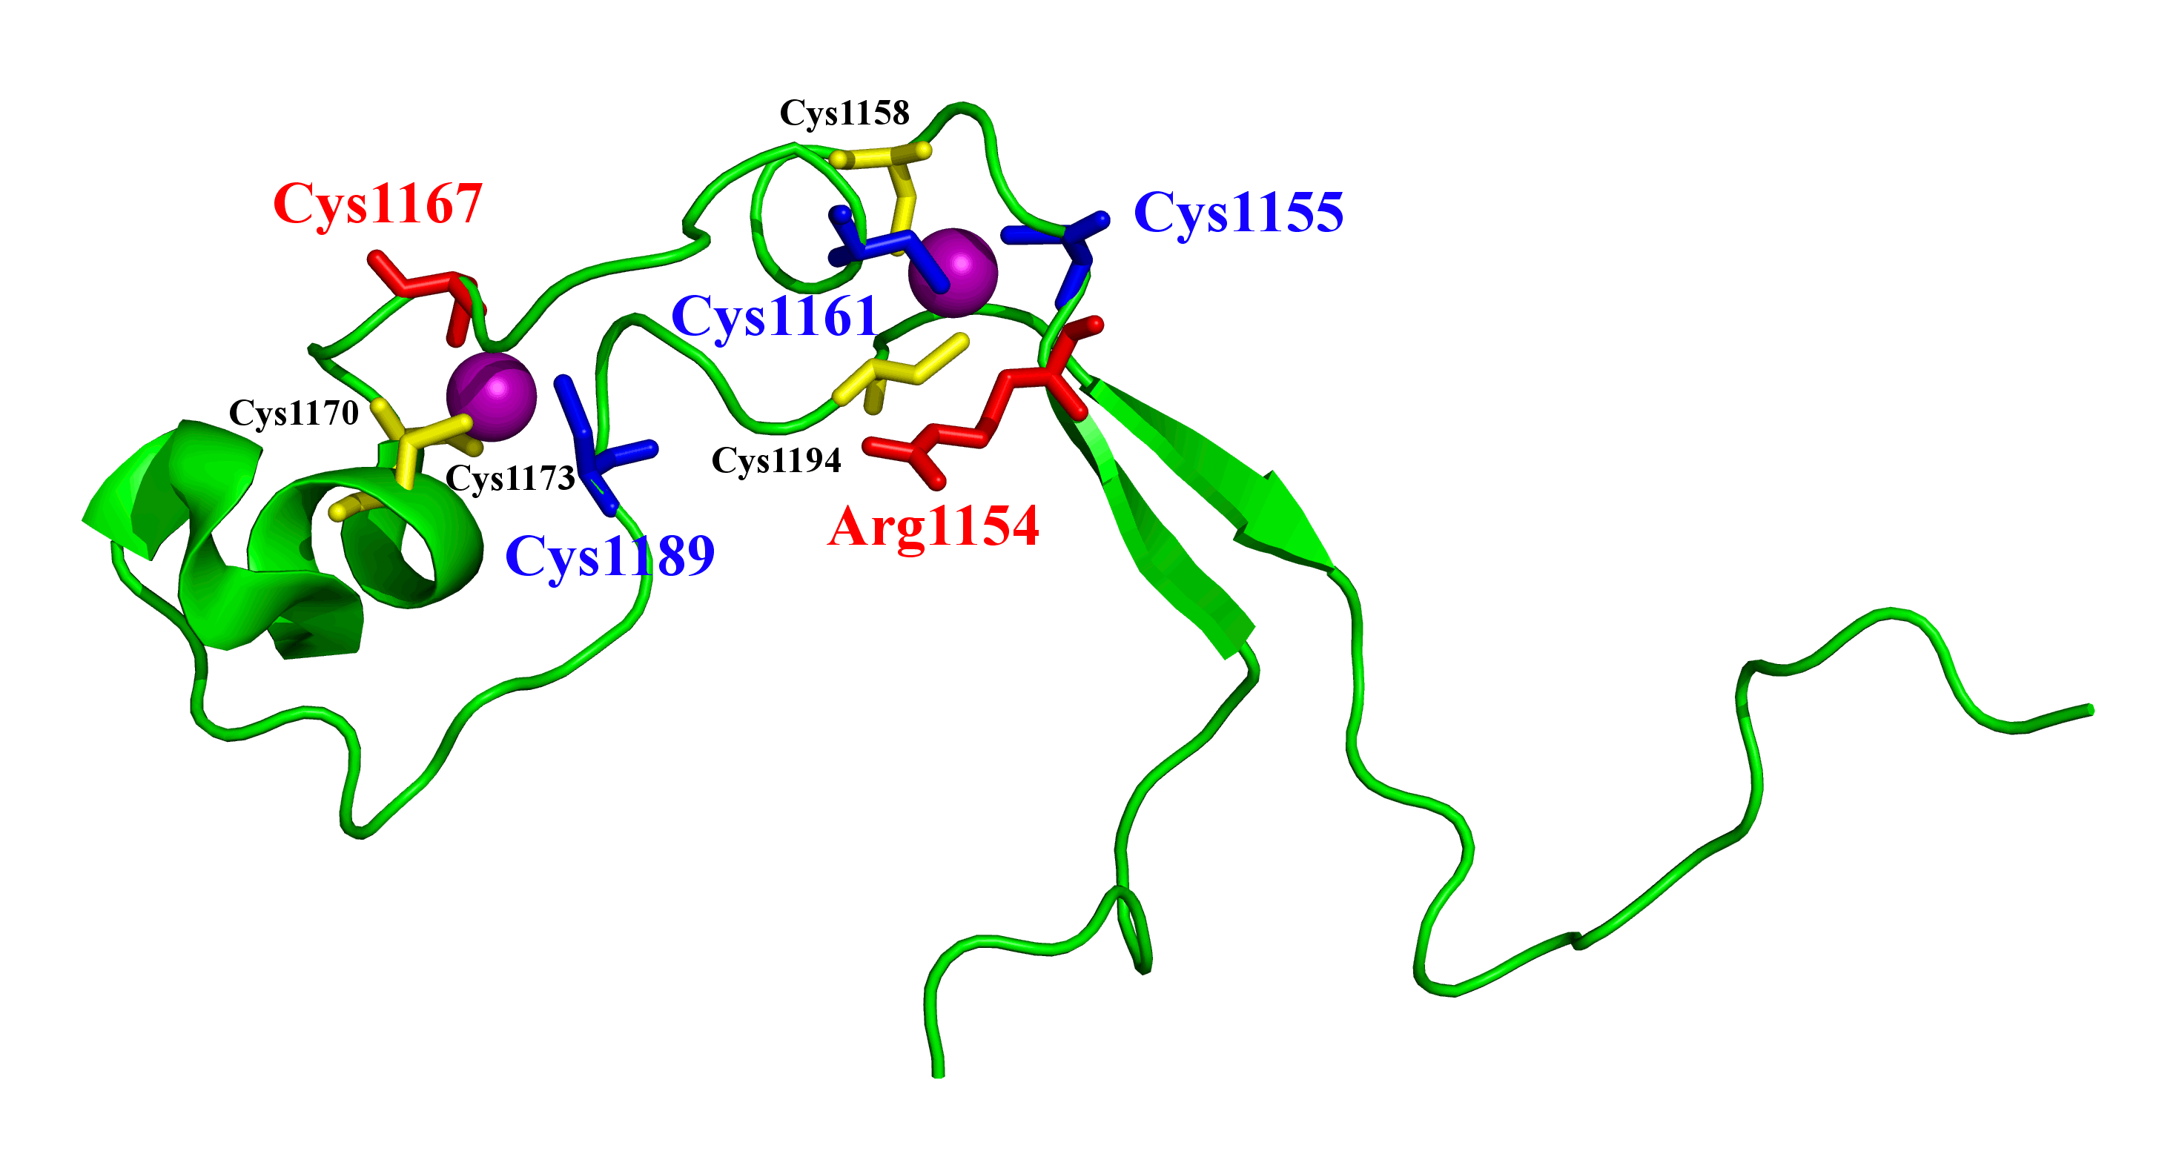
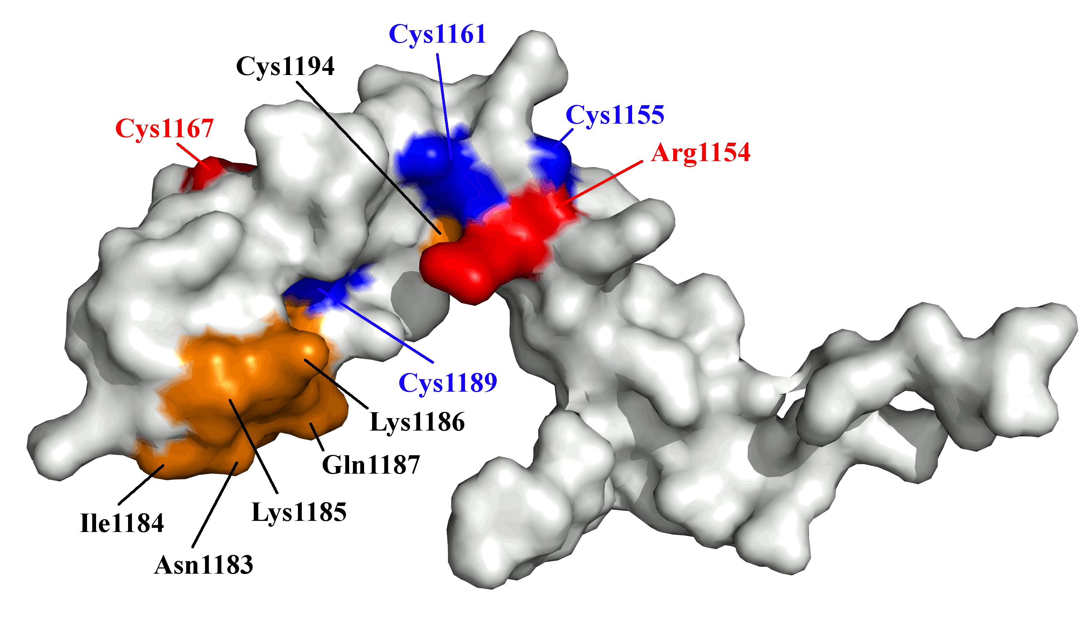
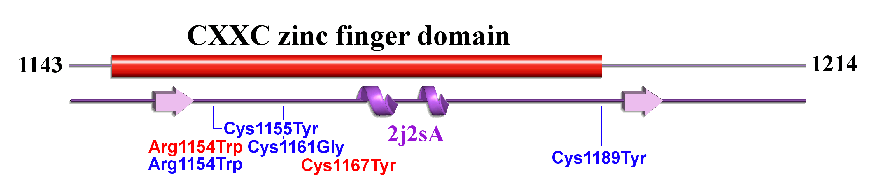
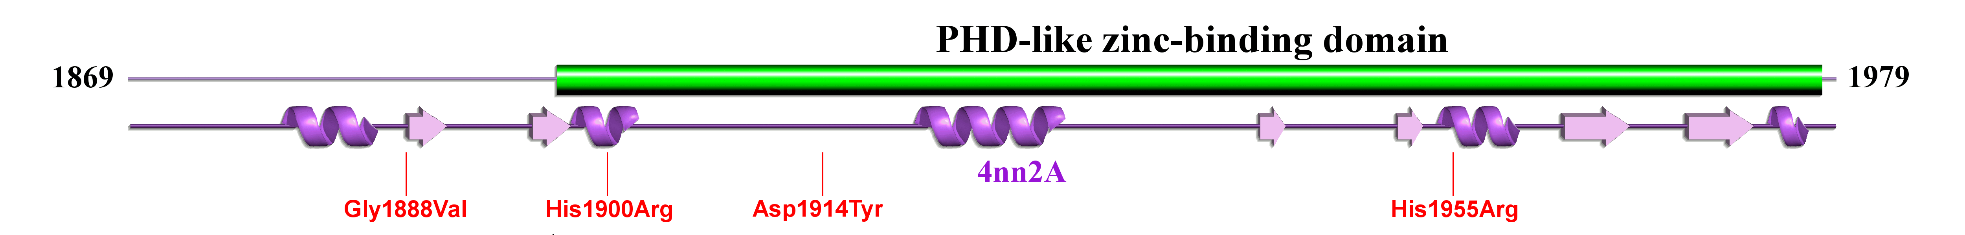
Distribution of KMT2A missense mutations
A
B
C
D

Slide 21
Infancy and Childhood
Increased body hair (82%)
Feeding problems (75%)
  Requiring percutaneous endoscopic gastrostomy (PEG) or percutaneous endoscopic jejunostomy (PEJ) tube feeding (17%)
Constipation (49%)
Hypotonia (44%)
Reflux (21%)

Slide 22
Infancy and Childhood
Seizures (17%)
Structural heart abnormality (16%)
Structural renal abnormality (10%)
Menstrual abnormalities (11%)
Increased frequency of infections (39%)

Slide 23
Eyes and Ears
50% (42/84) of individuals had one or more ophthalmological abnormality, these included:
  strabismus (18)
  myopia (10)
  hypermetropia (7)
  myopia (10).
Otitis media with effusion / recurrent otitis media / narrow ear canals (15%)

Slide 24
Delay and Learning Difficulties
85% (63/74) of individuals were classified as having mild, moderate or mild-to-moderate developmental delay or learning difficulties.
12% (9/74) individuals classified as having moderate-to-severe or severe developmental delay or learning difficulties
3% (2/74) of individuals having profound difficulties
3% (2/74) individuals had normal learning, this included a gentleman with a mosaic frameshift variant and an unrelated 8-year-old girl.

Slide 25
Learning
Type of School | Number of Individuals
Mainstream / Regular | 10
Mainstream / Regular with support | 9
Special needs school | 44
Unknown / Not yet at school / Homeschooled | 24

Slide 26
Learning
Strengths and Challenges
Language skills often highlighted as a strength
Reading skills highlighted as a strength
  However understanding not always there
Difficulties with mathematics

Slide 27
Adults
There is limited information available about adult outcomes.
There are 11 individuals > 18 years old in the study.
Two individuals work in a mainstream environment, two individuals work in sheltered environment. Three individuals live in sheltered living accommodation with minimal support.

Slide 28
Behavior
70% (61/87) of individuals had behavioral difficulties
21% (18/87) Abnormal fear / anxiety related behavior
21% (18/87) Autism / autistic behavior
18% (16/87) Aggressive behavior
13% (11/87) Attention deficit hyperactivity disorder
8% (7/87) Inflexible adherence to routines or rituals
10% (9/87) Self injurious behavior / head banging

Slide 29
Sleep
34 individuals (39%) of individuals had sleep disturbance.
Increasing evidence shows that chromatin remodelling events play a role in circadian regulation¹
In particular, KMT2A has been shown to interact with the core circadian transcription factor complexes CLOCK-BMAL1 and PER-CRY²
Individuals with WSS also have other features that may contribute to them having sleep disturbance:
  gastro-oesophageal reflux
  tendency towards otitis media with effusion
  behavioral difficulties.
1. Aguilar-Arnal L, Hakim O, Patel VR, Baldi P, Hager GL, Sassone-Corsi P. Cycles in spatial and temporal chromosomal organization driven by the circadian clock. Nat Struct Mol Biol. 2013;20(10):1206-13.
126.
2. Katada S, Sassone-Corsi P. The histone methyltransferase MLL1 permits the oscillation of circadian gene expression. Nat Struct Mol Biol. 2010;17(12):1414-21.
Notes:
34 individuals (39%) of individuals had sleep disturbance. Disrupted sleep patterns are observed in other developmental disorders such as Smith Magenis syndrome and can cause significant distress to families(37). Increasing evidence shows that chromatin remodelling events play a role in circadian regulation, reviewed by Aguilar-Arnal et al(38). In particular, KMT2A has been shown to interact with the core circadian transcription factor complexes CLOCK-BMAL1 and PER-CRY(39). Therefore, the disruption of sleep in WSS may result from an underlying disruption of circadian rhythm. Individuals with WSS also have other phenotypic features that may contribute to them having sleep disturbance including gastro-oesophageal reflux, tendency towards otitis media with effusion and behavioural difficulties.

Slide 30
Other Features
26% (22/84) of individuals were reported as having have swollen hands and or feet
31% Advanced eruption of teeth
39% Abnormality of pain sensation
3% fused cervical vertebrae
2% sleep apnoea

Slide 31
Weight of Individuals with Wiedemann-Steiner syndrome (WSS)
A
B
C
D
A. Birth weight of males. B. Birth weight of females. C. Weight of males. D. Weight of females

Slide 32
Height and OFC of Individuals with Wiedemann-Steiner syndrome
E
F
G
H
E. Height of males. F. Height of females. G. OFC of males. H. OFC of females

Slide 33
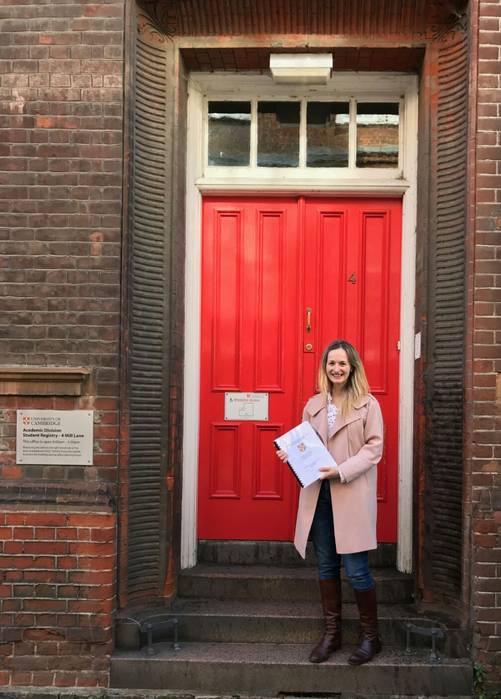
WSS Research in the UK
Wendy Jones
WTSI, GOSH
PhD completed and published
WiSH Study
  Research using stem cells generated from individuals with WSS
www.sanger.ac.uk/research/publications/theses.html Chapter 2

Slide 34



Helena Kilpinen
Career Development Fellow
University College London
Great Ormond Street Institute of Child Health
Wellcome Trust Sanger Institute
Albert Basson
Reader in the Centre for Craniofacial and Regenerative Biology
Kings College London

Slide 35

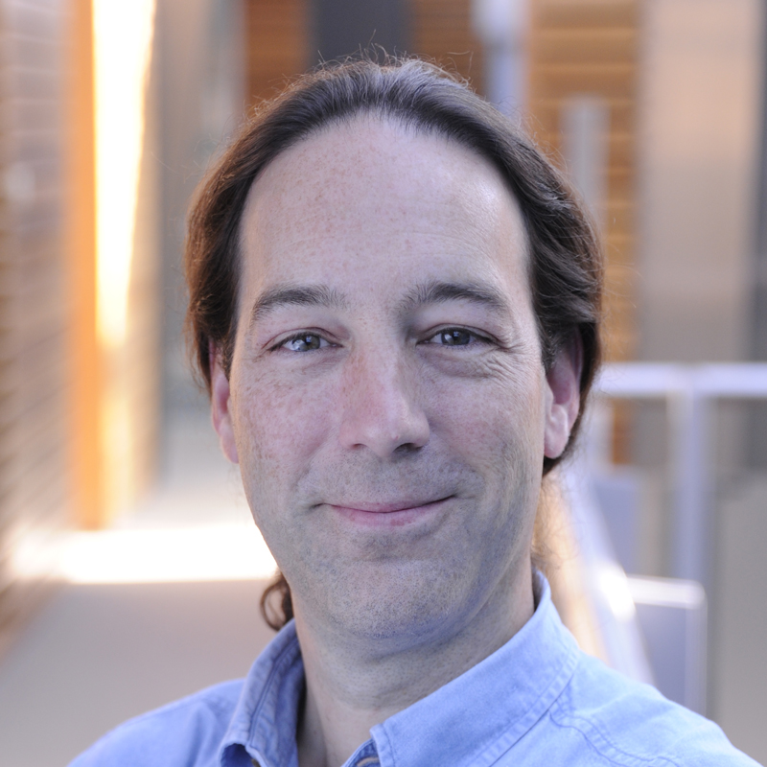
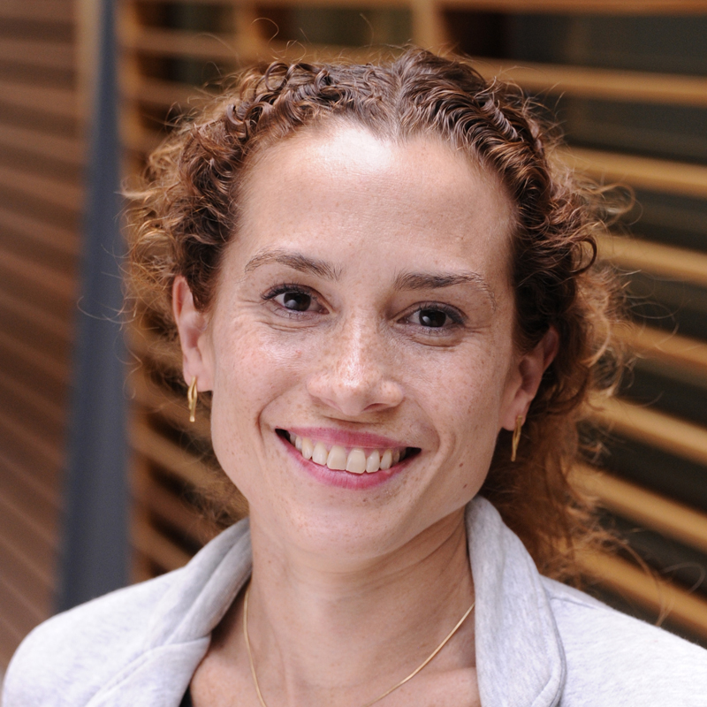
Matt Hurles
Head of Human Genetics
Senior Group Leader
Wellcome Trust Sanger Institute
Sebastian Gerety
Senior staff scientist
Wellcome Trust Sanger Institute
Gabi Gurria
Postdoctoral Fellow
Wellcome Trust Sanger Institute

