Slide 1
The CoRDS Registry at Sanford
Austin Letcher, MS
Sr. Research Associate
Sanford Research

Slide 3
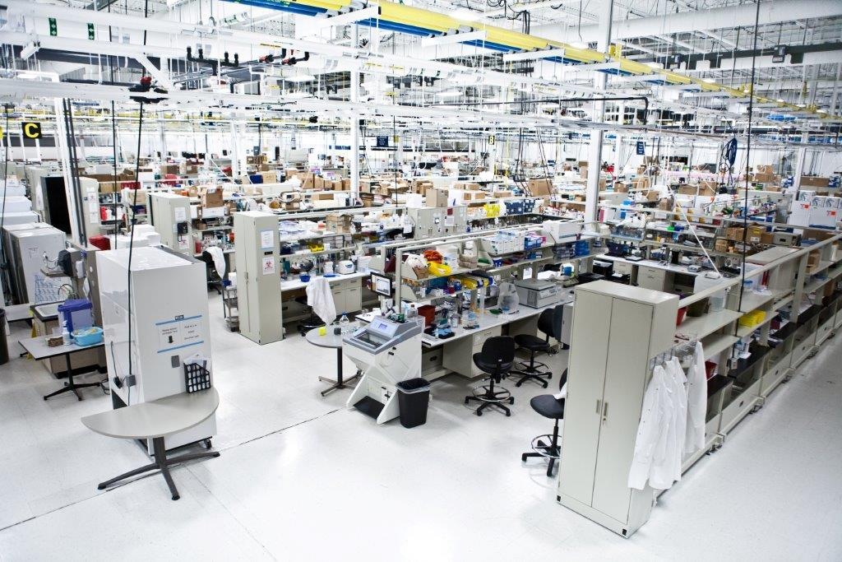
Sanford Research
We are the rapidly growing research arm of Sanford Health
Basic Science
Comprised of 39 independent principal investigators, ~245 full time research staff.
Clinical Research
Robust, integrated clinical research group, with over 400 open clinical trials.

Slide 4
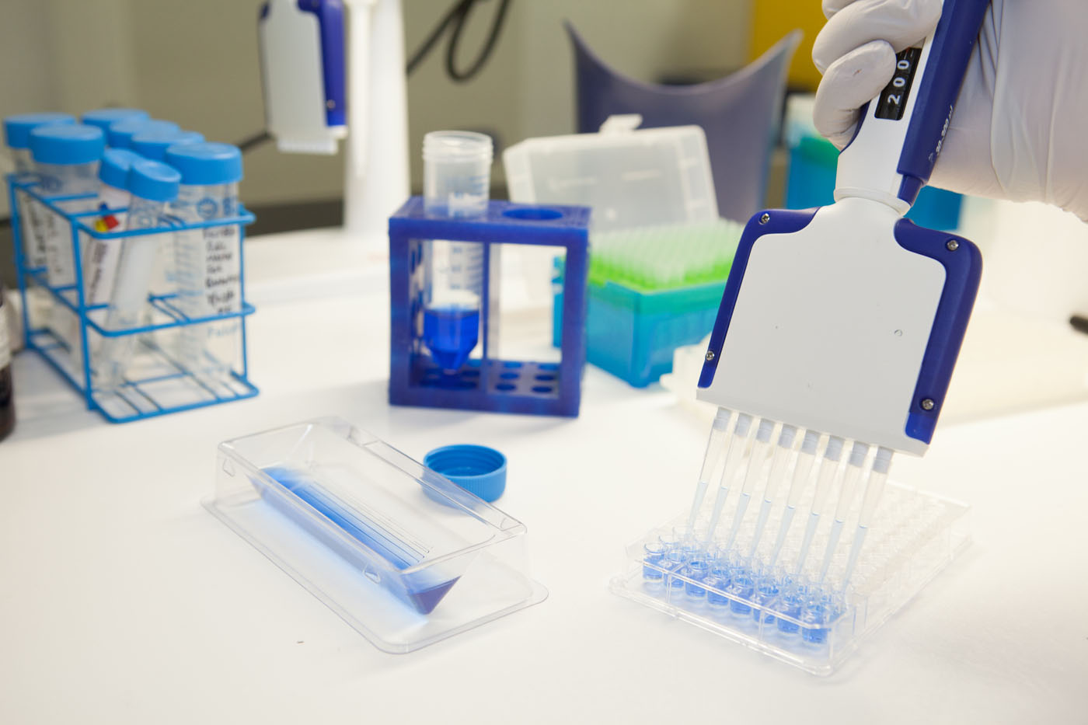
Rare Disease Research at Sanford
~23 laboratories seek to understand the underlying genetic, molecular, cellular and developmental causes of rare diseases.
Strengths, expertise, and interests include, among others:
Neurodegenerative diseases
Lipodystrophies
Ciliary associated disorders
Kidney diseases
Metabolic disorders

Slide 5
Patient Centered Approach
We understand that in rare disease, many times the patients and their family members are the experts.
In order to properly investigate a disease, researchers must have a full understanding of the disease’s natural history.
Out of these two ideas, Sanford Health has sponsored the development of the CoRDS Registry.

Slide 6
What is CoRDS?
CoRDS is a patient registry for all rare diseases, unaffected carriers & the undiagnosed - it ties together patients, advocacy groups, and researchers.
Unlike many other registries, as a Sanford Health sponsored initiative, CoRDS is made available at no cost to patients, advocacy groups, or researchers. It is free and it always will be.

Slide 7
How Does CoRDS Work?
Patients and their families can complete a questionnaire.
Advocates can create a disease-specific questionnaire.
Participants enroll in CoRDS by completing the questionnaire and keeping it updated.
Researchers and clinicians can apply for access to the data in CoRDS

Slide 9
How Can CoRDS Help?
Majority of rare diseases do not have a registry
Many rare disease cohorts have not yet found their community
Connects patients’ natural history data with researchers and clinicians

Slide 10
Who owns the data in CoRDS?
Participants are the primary owners of the data.
CoRDS stores and manages the information as required by the Sanford Research Internal Review Board (IRB).

Slide 11
Information Security
CoRDS never sells, rents, or leases personal information.
Information in CoRDS remains there unless consent to share is provided by the participant.

Slide 12
How is CoRDS Data Used?
Researchers
Petition, and can be approved by Sanford’s Scientific Review Committee, to receive de-identified patient data.
Patient Advocacy Group
Can use data for non-research purposes (education, grant applications, etc.)
Only after participant has given consent to share
Pharma
Industry can notify CoRDS of disease specific clinical trials. CoRDS will then direct participants to the appropriate pharma contact if interested in learning more about a clinical study.

Slide 13
Rare Disease Patients as CoRDS Participants
Many of the world’s experts in rare disease are the patients & families themselves!
In order to study the natural progression of a disease it is critical that participants update their information as frequently as their conditions change.
CoRDS will remind participants to update info annually
If completed annually, disease-specific questionnaires are analogous to natural history studies

Slide 14
Participation Cont’d
Questions may be changed or added
Document upload
Provide your genetic reports!
Patient participation creates the knowledgebase of mineable data

Slide 15
CoRDS Raises Awareness & Educates
New discoveries are made based on the information contained in the natural history of a disease.
Patients own their stories. By sharing each story, scientists and doctors learn more about how to approach rare disease research and treatment.

Slide 16
CoRDS Connects Patients and Researchers
Participating in CoRDS gives patients the chance to contribute to research – they can easily tap into “the scene!”
Information from the registry leads to better physician decisions and diagnoses, along with better industry models for drug development.

Slide 17
Wrapping up…
CoRDS is 100% free of charge for all participants.
Information from the CoRDS registry enables scientists to steer their research in the direction of novel discoveries.
Patients, advocacy groups, and researchers are all brought to one location to combine their strengths.
Again – CoRDS costs nothing but the time it takes to complete and update a profile

Slide 18
WSS Registry Data

Slide 19
WSS Registry Data
Average age at diagnosis: 6.0 ± 4.5 years (N=35)
Average IQ (N=7): 63.7
Std Dev: ± 17.7
Confidence Interval (90%): (59.5, 67.9)

Slide 20
WSS Registry Data
Other: Severe constipation, reflux, GERD, diarrhea

Slide 21
WSS Registry Data

Slide 22
WSS Registry Data
Mean number of hospitalizations:
4 hospital visits
Mean number of surgeries:
3 surgeries

Slide 23
WSS Registry Data
 | Walk | Speak words | Speak phrases | Bladder trained | Bowel trained
Mean | 2.04 | 2.06 | 3.40 | 3.92 | 4.59
Std Dev | 0.91 | 1.26 | 1.15 | 1.92 | 1.35
N | 30 | 27 | 22 | 16 | 14

Slide 24
WSS Registry Data

Slide 25
Summary

Slide 26
Thanks to all of our participants – and thank you for listening!
Austin.Letcher@sanfordhealth.org
www.sanfordresearch.org/specialprograms/cords

